Slide 1
Amino acid compositions of disordered protein regions differ by cell compartment.

Slide 2
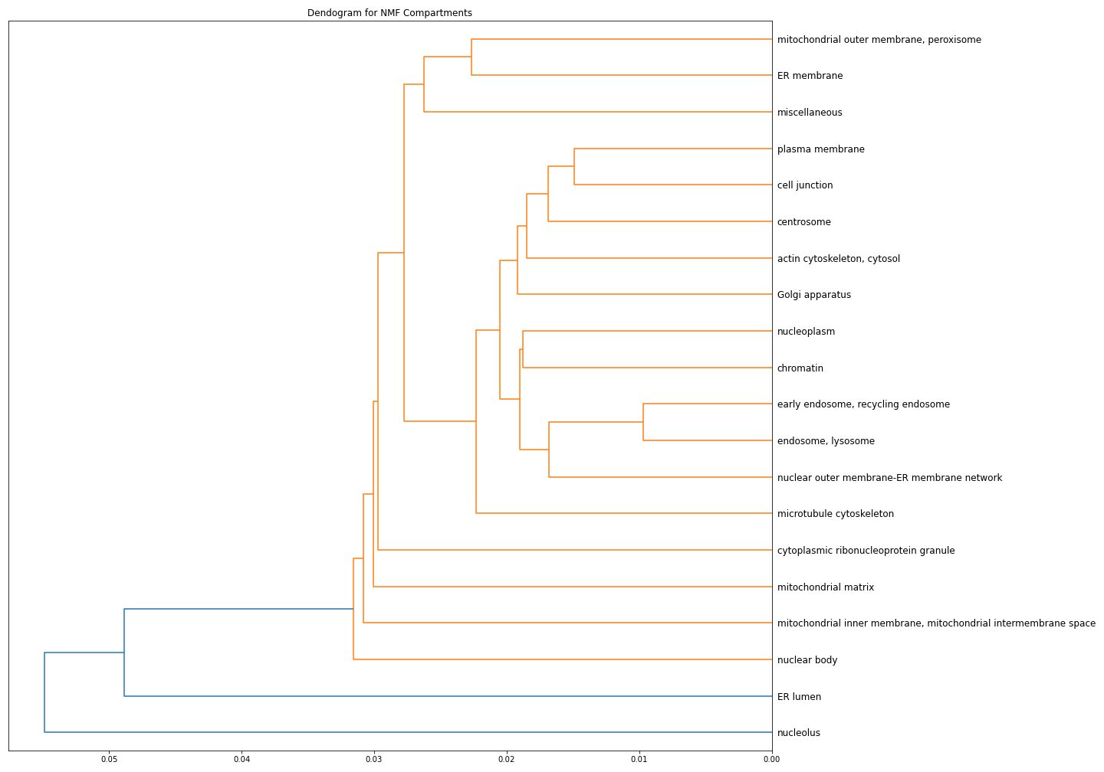
Amino acid compositions of disordered protein regions differ by cell compartment.
A
1
1
B
0
2
C
-.5
2
R
K

Slide 3
Amino acid compositions of disordered protein regions differ by cell compartment.
C
B
A
1
1
B
0
2
A
C
-.5
2
R
K

Slide 4
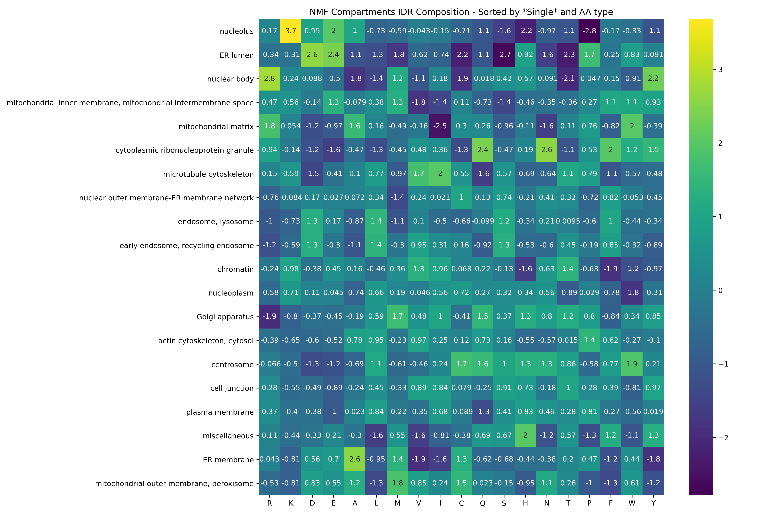
Amino acid compositions of disordered protein regions differ by cell compartment.
Z-score
Distance
Amino Acid

Slide 5
Amino acid compositions of disordered protein regions differ by cell compartment.
Z-score
Distance
Amino Acid

Slide 6
IDR composition as a secondary localization element
Secondary Localization Elements
Complex formation
Phase separation
Primary Localization Elements
Targeting signals
Nuclear import/export signals
Co-translational translocation

